Slide 1

Amrita Jena
Capstone Project-presentation
PGP - Data Science and Business Analytics. PGPDSBA Online May_B 2021

Slide 2
What’s our business problem
We all know that Health care is very important domain in the market. It is directly linked with the life of the individual; hence we have to be always be proactive in this particular domain. Money plays a major role in this domain, because sometime treatment becomes super costly and if any individual is not covered under the insurance, then it will become a pretty tough financial situation for that individual. The companies in the medical insurance also want to reduce their risk by optimizing the insurance cost, because we all know a healthy body is in the hand of the individual only. If individual eat healthy and do proper exercise the chance of getting ill is drastically reduced.
What is our objective
The objective of this exercise is to build a model, using data that provide the optimum insurance cost for an individual. You have to use the health and habit related parameters for the estimated cost of insurance.

Slide 3
Why insurance cost burden emerges
Service price and intensity
Population aging and growth
Disease prevalence or incidence
Medical service utilization
Unhealthy lifestyle

Slide 4
What our data says:
In exploring the dataset, we get the following information:
The dataset has 25000 observations and 24 variables.
There is total 10 categorical data types, 1 Boolean data type and 14 int data type
The target(dependent) variable is “insurance_cost” i.e. Y variable.
This is a regression problem under supervised learning .
We can choose either Linear or Non-Linear Regression depending on the underlying relationship between the dependent and the independent variable.

Slide 5
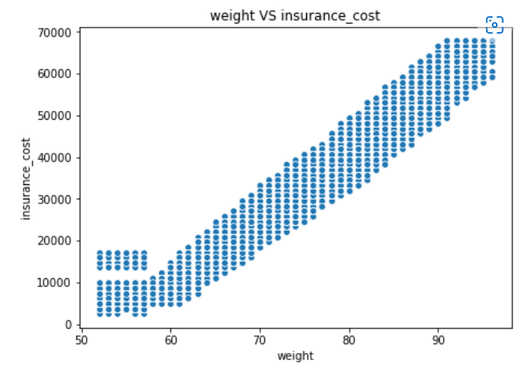
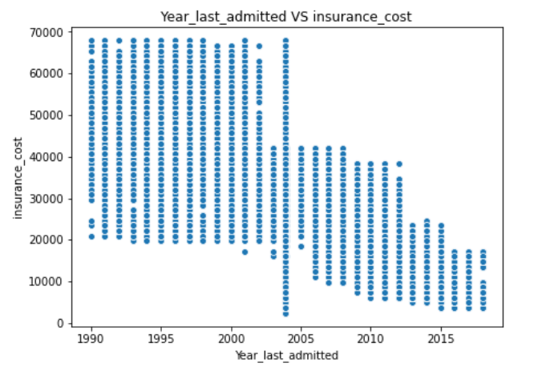
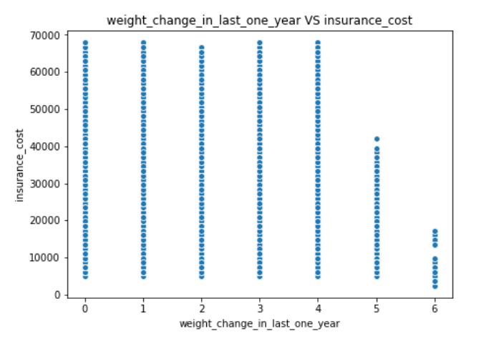
MODEL SELECTION
Out of the 24 features in our data “weight” is the most important feature (contributing 97%) in predicting the insurance cost followed by-Year_last_admitted and weight_change_in_last_one_year
In the graph, we can see a that only weight manifests linear relationship with insurance cost while the other two shows non linear relationship.
Hence along with Linear Regression analysis we will also do Decision Tree, Random Forest and Neural Network regressor analysis

Slide 6
Model Validation
Dropped two Unimportant Variables- applicant id and Location
As age was having large number of variables, I grouped age into “age_group” for easy analysis – Youth (15-24 years) Adults (25-64 years) Elderly (65 years and over)
Data Splitting –
We apportion the data into training and test sets, with an 70-30 split
Training set: This part of the data set is used to build and train the Machine Learning model.(70%) 
Testing set: This part of the data set is used to evaluate the efficiency of the model.(30%)

Slide 7
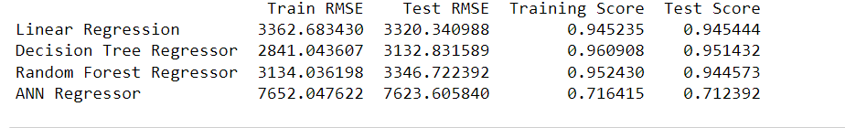
Model Comparison
If we compared all the Linear Regression Model and Decision Tree model are doing better with respect to prediction.
To select best it would be better to have more data for training, validating and testing.
As of now, Decision Tree model and Linear Regression Model looks to be more balance.
However Random Forest regression model is also not bad but requires further analysis.

Slide 8
Insights
The important feature for Insurance cost of individual from the data set provided is coming out to be weight followed by by-Year_last_admitted and weight_change_in_last_one_year
Variables like eating habit, sleep cycle and frequent pill popping habit which attributes to complications like renal failure should have been included.
Rather than daily and rare amount of alcohol and no of cigarettes consumed per day should have been included.
As BMI includes muscles and bone density. Visceral fat content should have been included as it is more reliable than BMI .
Applicant with unhealthy lifestyle should also have been included properly so that insurance cost on higher side could also have been studied significantly.

Slide 9
Recommendations
As cost of health care continues to rise. We have to learn how to take steps to limit your out-of-pocket health care costs.
From our analysis it is clear that weight is highly corelated with insurance cost and weight_change_in_last_one_year also shows some correlation with our target variable. Insurance holders should religiously follow weight management therapy to reduce insurance cost.
Increased number of hospitalizations also adds up to medical expenses hence one can get routine health screenings. These tests can catch health problems early, when they may be more easily treated. And one do not have to pay a huge sum when condition worsens .
Depending on your health coverage, you may have the choice to see providers who are in-network or out-of-network. You pay less to see providers who are in-network, because they have a contract with your health plan. This means they charge lower rates
A simple way to save money on health care is to stay healthy. Of course, that is sometimes easier said than done. But staying at a healthy weight, getting regular exercise, and not smoking lowers your risk for health problems. Staying healthy helps you avoid costly tests and treatments for ongoing conditions such as diabetes or heart disease.
Insurance companies may pay special attention to your lifestyle and profession. All information shared plays a key role in determining your suitability for the coverage and insurance costs.

